Slide 1

Introductory
MASTERCLASS
Week 1 Session
Presented by: Abdullah Zia
CYBERSTER
Blue Team Lead
21 June 2026
BLUE TEAM
Internship Program Batch # 02
SOC Operations
Digital Forensics
Hands-on Labs
cyberster.site

Slide 2
Welcome to the Blue Team
Welcome aboard. Being selected for this program means something. Over the next few months you will go from setting up your first security lab all the way to investigating real forensic cases. It will take effort, but everything worth building does. We are here with you the whole way.
⚙
🎓
💼
Real Skills
Guided Learning
Career Proof
You will spend most of your time in the lab, not reading slides. Expect to get your hands dirty with real tools used by professionals in the field.
You are not doing this alone. Your mentors will be with you every step, answering questions and reviewing your work throughout the program.
Everything you build and submit becomes part of your portfolio. You leave with solid, demonstrable evidence of what you can do for real employers.

Slide 3

Meet Your Lead
Defensive Security
Focus is entirely on the defensive side of cybersecurity, SOC work, and protecting systems from real threats.
SOC and Threat Detection
Practical background in building monitoring environments and catching real threats before they cause damage.
Abdullah Zia
Digital Forensics
Blue Team Lead
Experience investigating incidents and pulling together evidence from disk, memory, and logs.
Cyberster Internship Program
Teaching Approach
The goal is to make sure you understand, not just follow steps. Questions are always welcome.

Slide 4
About Cyberster
Who We Are
⚔
🛡
🔄
Cyberster is a community built around practical cybersecurity education. The internship runs across four tracks. Each track is independent, focused, and designed to give you real skills in your chosen area. The Blue Team track is where defense, monitoring and investigation happen.
Red Team
Blue Team
Purple Team
Offensive security and attack simulation
Defense, monitoring and incident response
Bridging attack and defense together
What We Stand For
Our Core Principles
Ethics
Trust
🔒 Ethics — How you work matters as much as what you produce.
The way you work matters as much as the work itself.
What is shared inside stays inside. Always.
🤝 Trust — Confidentiality is the foundation of this community.
🎯 Discipline — Consistency separates real learning from attendance.
Discipline
Integrity
Consistent effort separates learning from just attending.
Your work should always be your own. No shortcuts.
✅ Integrity — Your report, your work, your name on it. Always.

Slide 5
Program Overview
Program
Cyberster Blue Team Internship
Duration
Three months, running across two back-to-back phases
Phase One
SOC Operations and SIEM work, focused on Wazuh
Phase Two
Digital Forensics and Incident Response
Main SIEM Tool
Wazuh, with Suricata for network intrusion detection
Forensics Tools
Autopsy, FTK Imager, EZ Tools, log2timeline
Lab Setup
VirtualBox or VMware running Kali Linux, Ubuntu and Windows VMs
Format
Self-paced tasks with live sessions at key points in the program

Slide 6
PHASE ONE
Weeks 1 to 6
SOC Operations and SIEM with Wazuh
🖥
👁
📁
Lab Setup
Wazuh SIEM
File Integrity
Build a virtual lab with Kali, Ubuntu, and Windows. Set up the network so all three machines talk to each other.
Install Wazuh from the ground up and connect your VMs to it as agents. Start reading and triaging alerts.
Monitor key directories for changes in real time. Write custom detection rules and tune out false alarms.
🔍
🧠
🦠
Suricata IDS
Threat Intelligence
Malware Analysis
Set up Suricata alongside Wazuh so network-level threats show up in the same dashboard as host events.
Pull in threat feeds from VirusTotal and Abuse.ch. Learn how to find and prioritize real vulnerabilities.
Analyse malware samples using static and dynamic methods. Write an incident response plan from scratch.

Slide 7
PHASE TWO
Weeks 7 to 12
Digital Forensics and Incident Response
💽
🪟
🌐
Disk Imaging
Windows Artifacts
Browser Forensics
Create proper forensic images, verify their integrity with hashes and document the chain of custody.
Dig into Event Logs, Prefetch files and execution history to understand what happened on a machine.
Pull browsing history, downloads, cookies and cached data from Chrome, Firefox and Edge.
🔗
🗂
⚖
LNK Files
Registry Forensics
M57 Capstone
Analyse shortcut files and jump lists to trace which files were opened and which USB drives were plugged in.
Read the Windows Registry to find user activity, installed software, USB device history and persistence.
Your final investigation. A real-world style case involving IP theft where you produce a report ready for court.

Slide 8
Tools You Will Work With
Phase One: SOC Tools
Phase Two: DFIR Tools
Wazuh SIEM
FTK Imager
Suricata IDS
Autopsy
Wireshark
EZ Tools Suite (PECmd, LECmd, RECmd...)
tcpdump
Registry Explorer
pfSense Firewall
log2timeline and plaso
ANY.RUN Sandbox
ChromeHistoryView
VirusTotal
Thumbcache Viewer
URLhaus and Abuse.ch

Slide 9
How to Submit Your Weekly Work
via LinkedIn
Compile a Weekly Report Post
Tag Cyberster and Your Instructor
01
Gather all your work for the week into a single LinkedIn post. Include all written reports and key screenshots proving actual work was done not just theory.
02
Tag @Cyberster and your assigned instructor in the post. Add a short description of what the week covered and what you learned.
Share the Link in the Group
Show Real Work in Reports
03
Once published, share the LinkedIn post link in your discussion group so mentors can find and review your submission.
04
Reports must include screenshots that prove steps were performed. Reviewers must be able to see through your report that real hands-on work was completed.
⚠ Do NOT copy anyone's report. Our review team actively checks for plagiarism. Copied submissions may result in termination from the internship. Write your own original work every week.

Slide 10
System Requirements
Component
Minimum
What We Recommend
Processor
Intel Core i5 6th Gen or AMD Ryzen 5
Intel Core i7 or AMD Ryzen 7
Memory
8 GB RAM
16 GB RAM
Storage
256 GB SSD
512 GB SSD
Operating System
Windows 10 or 11, or any Linux distro
Dual boot or WSL2 setup
Internet
Stable WiFi or wired connection
Wired connection preferred
Do not use a hard drive. Virtual machines need an SSD to run properly. If your laptop has a spinning drive, the labs will be very slow and frustrating. The memory recommendation is also worth taking seriously, as you will often have several VMs running at the same time.
!

Slide 11
What You Are Building
By the end of the program you will have:
Why It Matters
✓
A working SOC lab that you built from scratch
The security industry does not care about certificates as much as it cares about what you can actually do.
✓
Hands-on malware analysis experience
The tasks in this program are the kinds of things you will be asked to do in a real SOC analyst or forensics role.
✓
A complete forensic investigation report
✓
Findings mapped to MITRE ATT&CK
Every report you submit is a piece of your portfolio. Treat it that way. Three months from now you will have something real to show.
✓
Proficiency in tools used in real jobs
✓
A portfolio you can show on LinkedIn

Slide 12
What Happens Next
Week One: SOC Foundations and Lab Setup — VirtualBox, Kali Linux, Ubuntu Server, Windows 10, networking basics, and your first look at Wazuh architecture.
Install VirtualBox
Read the Roadmap
Download VirtualBox and start pulling the Kali, Ubuntu and Windows ISOs before the next session so you are not waiting on downloads.
Go through the full roadmap that was shared in your group. It gives you a clear picture of where you are going over the next three months.
01
02
Say Hello
Show Up on Time
03
Write your name in the discussion group if you have not already. It helps the mentors know who is active and who to watch out for.
04
Each session is at 9 PM PKT. Convert the time to your timezone and set a reminder. If you have exams, contact support before leaving.

Slide 13
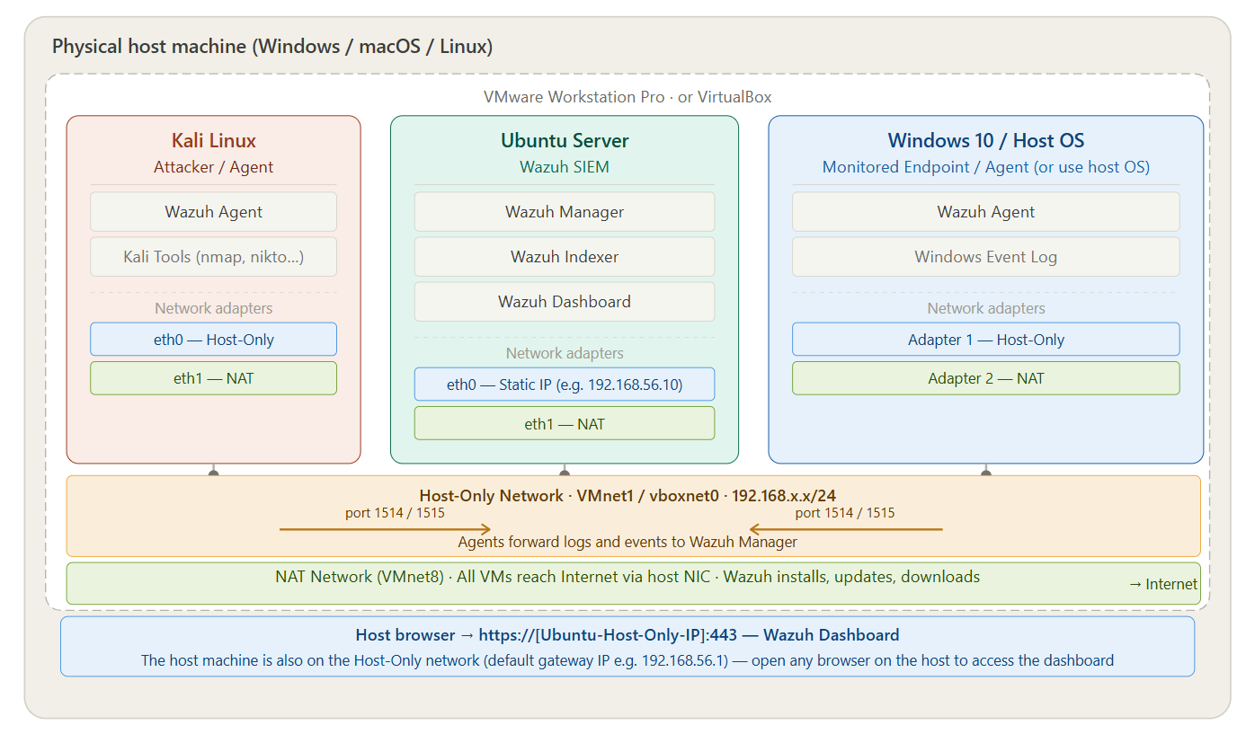
Week 1 Lab Topology

Slide 14
Community & Support
You are not alone — we are all learners here.
This internship is a community. Everyone is here to grow, and we make room for every kind of question.
💬
📅
📣
Ask Anything in the Group
Exams or Scheduling Conflicts
Stay Active in the Discussion Group
Do not hesitate to ask questions in the discussion group even if you think it is a very basic thing to ask. There is no such thing as a stupid question here. We are all learners and the whole community will accommodate you and help you out.
All updates, task instructions, session reminders, and submission links will be shared through the discussion group. Stay active, stay engaged, and help others when you can. A strong community makes for a stronger program.
We understand that most participants are students and life gets busy like exams, personal commitments, and emergencies happen. If you have any problem or need to step away temporarily, please contact the support number and notify them before leaving. They will accommodate you and provide a solution.

Slide 15
Let's Build Something Real
Good analysts are built through repetition, curiosity and not giving up when something does not work the first time.
That is what the next three months are about.
Welcome to the Blue Team.
Questions? Drop them in the discussion group.
cyberster.site | Blue Team Lead: Abdullah Zia | 21 June 2026

